Slide 1
AGILE TESTING
WHAT IS AGILE?
AUTOMATION TESTING FOR AGILE METHODOLOGY

Slide 2

What is Agile?

Slide 3

AGILE is a methodology that promotes continuous iteration of development and testing throughout the software development life cycle of the project. Both development and testing activities are concurrent unlike the Waterfall model

Slide 4

Agile Manifesto
The agile software development emphasizes on four core values:
Individual and team interactions over processes and tools
Working software over comprehensive documentation
Customer collaboration over contract negotiation
Responding to change over following a plan

Slide 5
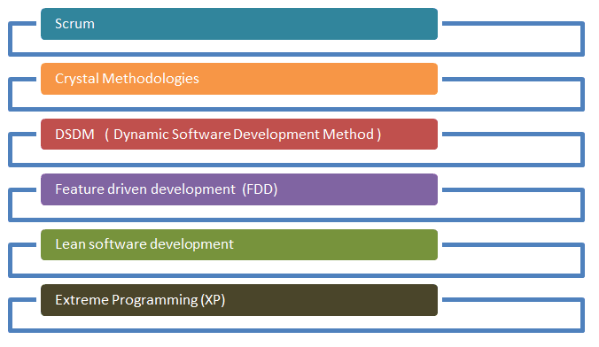
Methodologies of Agile Testing

Slide 6
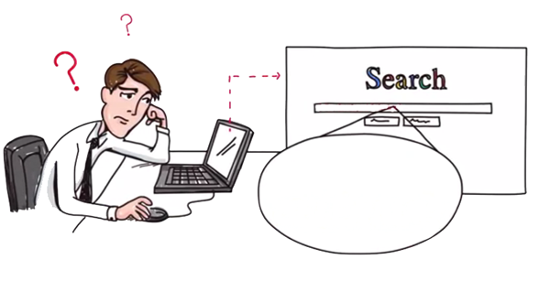
What is Agile Testing?
What is Agile Testing?

Slide 7

Unlike the Waterfall method, Agile Testing can begin at the start of the project with continuous integration between development and testing.
Agile Testing is not sequential (in the sense it’s executed only after coding phase) but continuous.

Slide 8

Agile team works as a single team towards a common objective of achieving Quality.

Slide 9

Agile Testing has shorter time frames called iterations
(say from 1 to 4 weeks).
This methodology is also called release, or delivery driven approach
since it gives a better prediction on the workable products in short duration of time

Slide 10
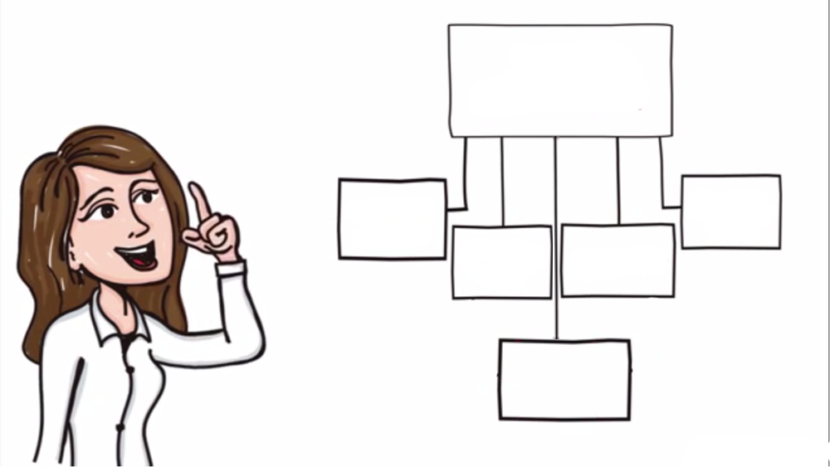
Agile Testing
QA Challenges with Agile Software
Test Plan for Agile
Agile Testing Strategies
Agile Testing Quadrant
Risk of Automation in Agile Process

Slide 11

Test Plan for Agile
In an agile model, test plan is written and updated for every release. Typical test plans in agile includes
1) Testing Scope
2) New functionalities which are being tested
3) Level or Types of testing based on the features complexity
4) Load and Performance Testing
5) Infrastructure Consideration
6) Mitigation or Risks Plan
7) Resourcing
8) Deliverables and Milestones

Slide 12
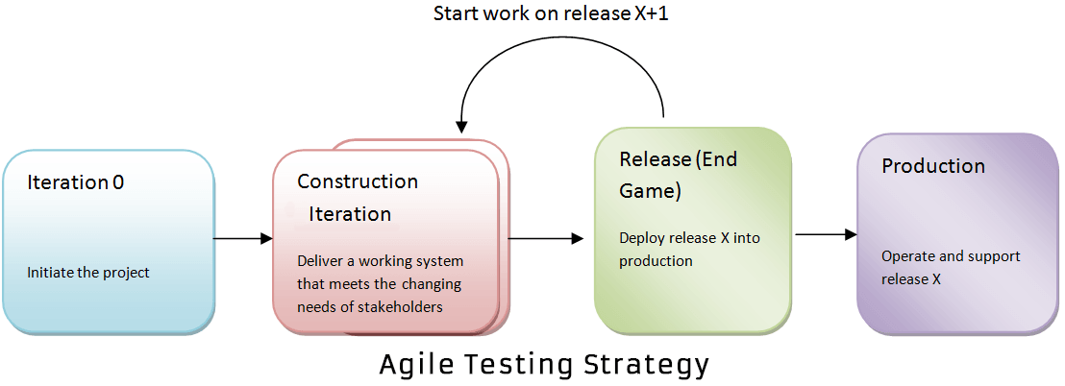
Agile Testing Strategies

Slide 13
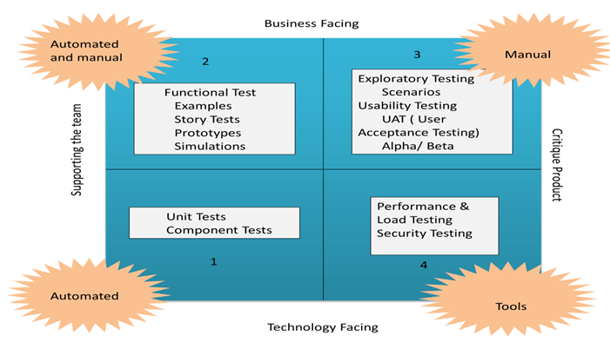
The Agile Testing Quadrant

Slide 14

QA challenges with agile software development
Chances of error are more in agile,
as documentation is given less priority, eventually puts more pressure on QA team.
Requirement changes and updates are inherent in an agile method, becoming the biggest challenge for QA

Slide 15

QA Challenges
New features are introduced quickly,
which reduces the available time for test teams to identify whether the latest features are according to the requirement and does it truly address the business suits
Test execution cycles are highly compressed

Slide 16

Testers are often required to play a semi-developer role
Change in their role from being a gate-keeper of quality to being a partner in Quality
Very less time to prepare test plan
For regression testing, they will have minimal timing

Slide 17

Risk of Automation in Agile Process
Automated UI provides a high level of confidence, but
they are slow to execute, fragile to maintain and expensive to build.
Automated tests are not a replacement for an exploratory manual testing.
To obtain the expected quality of the product, a mixture of testing types and levels is required

Slide 18

In order to save time, many times automation test plan is poorly planned or un-planned which results in the test fail
RISKS
Members of agile automation team must be effective consultants: approachable, cooperative, and resourceful,
or this system will quickly fail
Automated testing may be so successful that they run out of important problems to solve, and thus turn to unimportant problems.

Slide 19
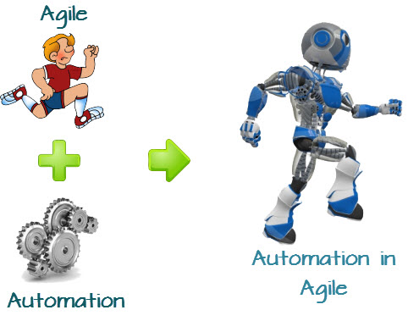
Automation Testing for Agile Methodology:

Slide 20
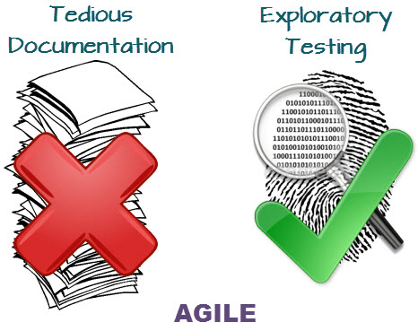
Agile methodology talks about doing away with laborious and tedious documentation so that new, innovative and explorative ideas could be implemented.

Slide 21
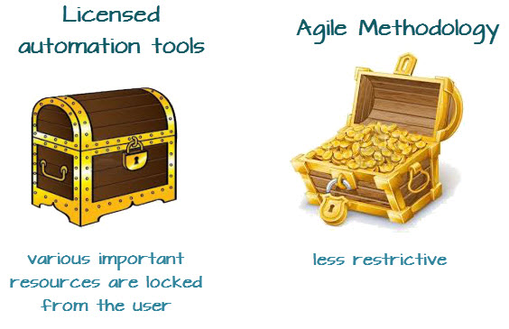

Licensed automation tools impose strict security access criterion to different types and levels of users
Agile methodology emphasizes upon mostly open collaboration and open ended interaction between team members

Slide 22
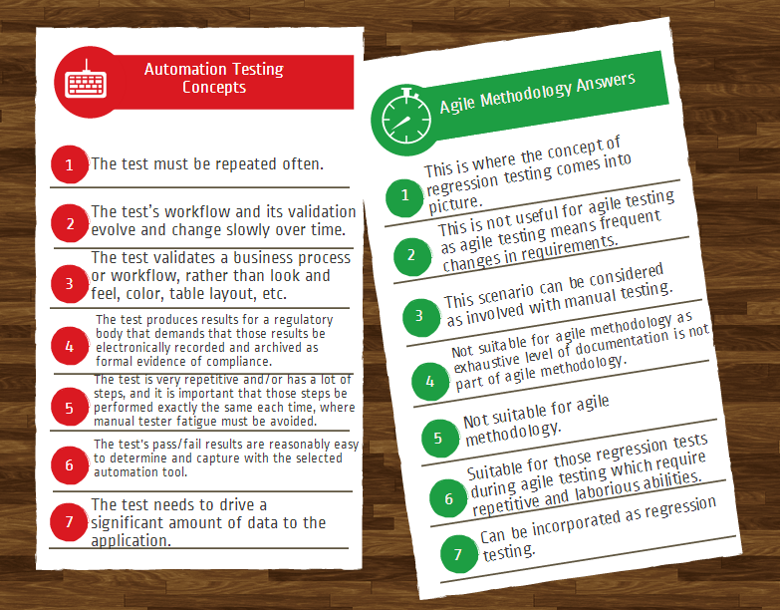
Notes:
Now let us look at the most basic situations whereby automation testing can be used and how we can adopt the same towards the realm of agile testing.

